Slide 1

UNIT 1

Slide 2

Computer Network
A network is a set of devices connected by a media link.
Devices often referred to as nodes can be a computer, printer, or any other devices capable of sending/ receiving data.
A computer network, often simply referred to as a network, is a collection of computers and devices interconnected by communications channels that facilitate communications and allows sharing of resources and information among interconnected devices.
1

Slide 3
Goals of Computer Networks
To provide sharing of resources such as information or processors.
To provide inter-process communication among users and processors.
It provides the network user with maximum performance at minimum cost.
It provides centralized control for a geographically distributed system.
It provides compatibility of dissimilar equipment and software.
It provides centralized management and allocation of network resources.
It provides distribution of processing functions.

Slide 4
Applications of Computer Networks
Business
Home
Mobile

Slide 5
Data Communication
Data Communications is the transfer of data or information between a source and a receiver.
The source transmits the data, and the receiver receives it.
Data Communication is interested in : The transfer of data, the method of transfer and the preservation of the data during the transfer process.

Slide 6

Types of Internetwork
Intranet
2. Internet
3. Extranet

Slide 7
Data Communication Effectiveness
The effectiveness of a data communication system depends on the following fundamental characteristics:
Delivery: The System must deliver data to the correct destination. Data must be received by the intended device or user and only by that device or user.
Accuracy: The system must deliver data accurately. Data that have been altered in transmission and left uncorrected are noise.

Slide 8
Data Communication
Timeliness: The system must deliver data in a timely manner. Data delivered late are useless. In the case of video, audio, and voice data, timely delivery means delivering data as they are produced, in the same order that they are produced, and without significant delay. This kind of delivery is called real-time transmission.
Jitter: Jitter refers to the variation in the packet arrival time. It is the uneven delay in the delivery of audio or video packets. For example, let us assume that video packets are sent every 30 ms. If some of the packets arrive with 30-ms delay and others with 40-ms delay, an uneven quality in the video is the result.

Slide 9
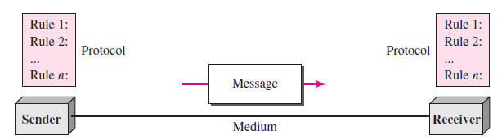
Data communication Components
A data communications system has five components:

Slide 10
Data communication Components
Message: The message is the information (data) to be communicated. Popular forms of information include text, numbers, pictures, audio, and video.
Sender: The sender is the device that sends the data message. It can be a computer, workstation, telephone handset, video camera, and so on.
Receiver: The receiver is the device that receives the message. It can be a computer, workstation, telephone handset, television, and so on.
Transmission medium: The transmission medium is the physical path by which a message travels from sender to receiver. Some examples of transmission media include twisted-pair wire, coaxial cable, fiber-optic cable, and radio waves.
Protocol: A protocol is a set of rules that govern data communications. It represents an agreement between the communicating devices.

Slide 11
Data Representation
Information today comes in different forms such as text, numbers, images, audio, and video.

Slide 12
Data Representation
Text: In data communications, text is represented as a bit pattern, a sequence of bits (0s or 1s). Different sets of bit patterns have been designed to represent text symbols. Each set is called a code, and the process of representing symbols is called coding. Today, the prevalent coding system is called Unicode, which uses 32 bits to represent a symbol or character used in any language in the world.
Numbers: Numbers are also represented by bit patterns. However, a code such as ASCII is not used to represent numbers; the number is directly converted to a binary number to simplify mathematical operations.

Slide 13
Data Representation
3. Images: Images are also represented by bit patterns. In its simplest form, an image is composed of a matrix of pixels (picture elements), where each pixel is a small dot. The size of the pixel depends on the resolution. For example, an image can be divided into 1000 pixels or 10,000 pixels. In the second case, there is a better representation of the image (better resolution), but more memory is needed to store the image.
Each pixel in image has been assigned a bit pattern. For black and white images, 1-bit pattern is used to represent a pixel. For gray scale images, 2-bit pattern is used i.e. A black pixel can be represented by 00, a dark gray pixel by 01, a light gray pixel by 10, and a white pixel by 11. For colour images several methods are used for representation i.e. RGB (combination of red, green and blue), YCM (combination of yellow, cyan and magenta).

Slide 14
Data Representation
4. Audio: Audio refers to the recording or broadcasting of sound or music. Audio is by nature different from text, numbers, or images. It is continuous, not discrete. Even when we use a microphone to change voice or music to an electric signal, we create a continuous signal.
5. Video: Video refers to the recording or broadcasting of a picture or movie. Video can either be produced as a continuous entity (e.g., by a TV camera), or it can be a combination of images, each a discrete entity, arranged to convey the idea of motion.

Slide 15
Data Flow/Transmission Modes
Simplex: Communication always in one direction e.g. Television
Half duplex: Communication may in either direction, but only one way at a time e.g. walky-talky
Full duplex: Communication may in both directions at the same time e.g. telephone

Slide 16
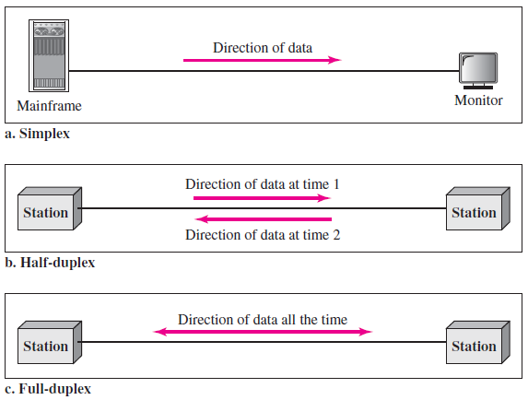

Slide 17
Type of Connection
A network is two or more devices connected through links. A link is a communications pathway that transfers data from one device to another. For communication to occur, two devices must be connected in some way to the same link at the same time. There are two possible types of connections: point-to-point and multipoint.

Slide 18
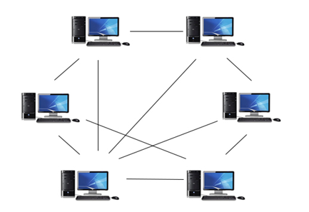
Point-to-Point:
Point-to-Point network is a network in which all the computers are linked together with equal privilege and responsibilities for processing the data.
Point-to-Point network is useful for small environments, usually up to 10 computers.
Point-to-Point network has no dedicated server.
Special permissions are assigned to each computer for sharing the resources, but this can lead to a problem if the computer with the resource is down.

Slide 19
Advantages Of Point-to-Point Network:
It is less costly as it does not contain any dedicated server.
If one computer stops working but, other computers will not stop working.
It is easy to set up and maintain as each computer manages itself.
Disadvantages Of Point-to-point Network:
In the case of Point-To-Point network, it does not contain the centralized system . Therefore, it cannot back up the data as the data is different in different locations.
It has a security issue as the device is managed itself.

Slide 20
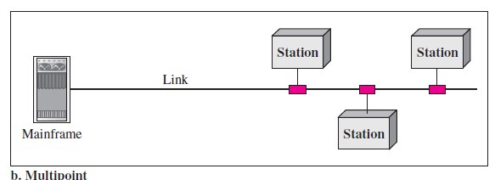
Multipoint
A multipoint (also called multidrop) connection is one in which more than two specific devices share a single link. In a multipoint environment, the capacity of the channel is shared. If several devices can use the link simultaneously, it is a spatially shared connection. If users must take turns, it is a timeshared connection.

Slide 21
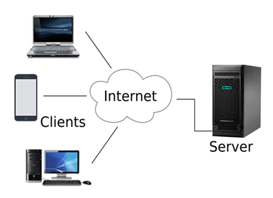
Client/Server Network
Client/Server network is a network model designed for the end users called clients, to access the resources such as songs, video, etc. from a central computer known as Server.
The central controller is known as a server while all other computers in the network are called clients.

Slide 22
Advantages Of Client/Server network:
A Client/Server network contains the centralized system. Therefore we can back up the data easily.
A Client/Server network has a dedicated server that improves the overall performance of the whole system.
Security is better in Client/Server network as a single server administers the shared resources.
It also increases the speed of the sharing resources.
Disadvantages Of Client/Server network:
Client/Server network is expensive as it requires the server with large memory.
A server cost is very high.
It requires a dedicated network administrator to manage all the resources.

Slide 23
Network Topology
a) Topology defines the structure of the network of how all the components are interconnected to each other.
b) Each topology is suited to specific tasks and has its own advantages and disadvantages.
c) The choice of topology is dependent upon type and number of equipment being used, rate of data transfer required, response time, and cost.
There are two types of topology:
1. physical topology
2. logical topology.

Slide 24
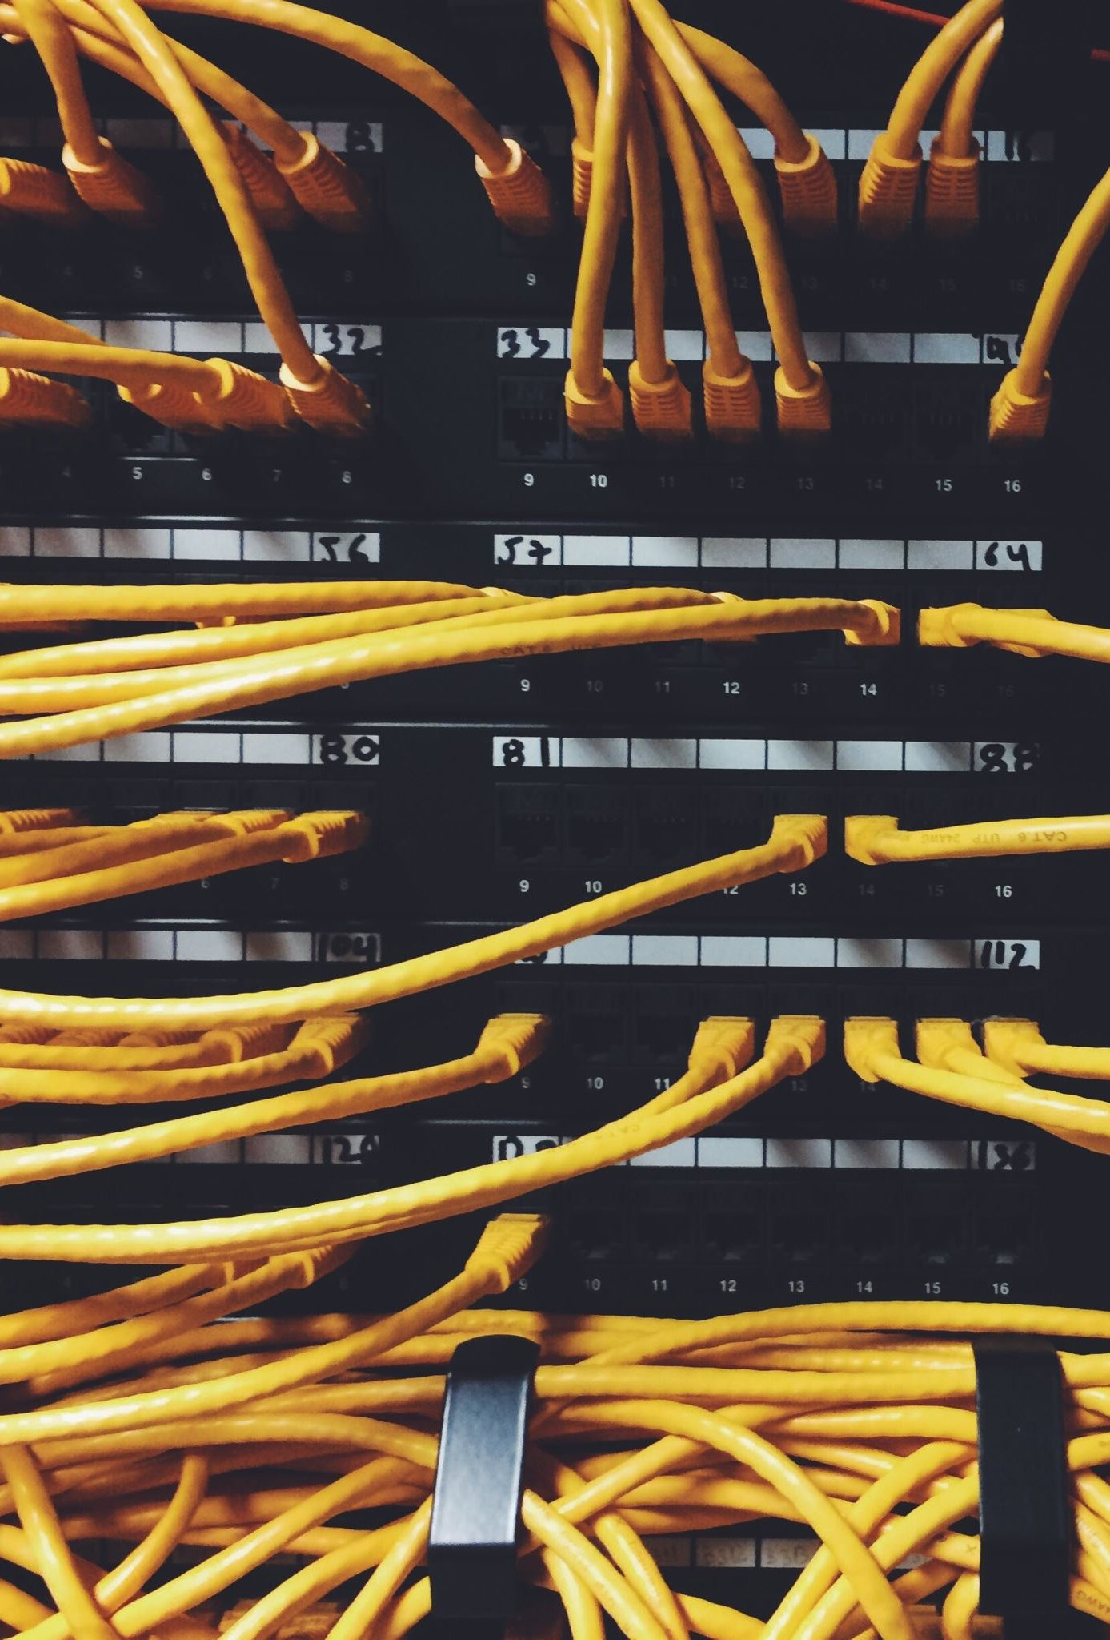
Network Topology
Following points need to remember to select a topology:
Application S/W and protocols.
Types of data communicating devices.
Geographic scope of the network.
Cost.
Reliability.

Slide 25
Types of Network Topology
Mesh topology.
Star topology.
Bus topology.
Ring topology.
Cellular topology
Hybrid topology
Note:
Ring and mesh topologies are felt convenient for peer-to-peer transmission.
Star topology is more convenient for client server.
Bus topology is equally convenient for either of them.

Slide 26
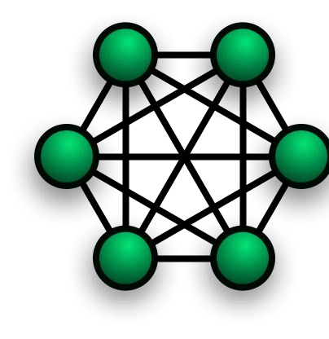
Mesh Topology
Every device has a dedicated point-to-point link to every other device.
The term dedicated means that the link carries traffic only between the two devices it connects.
To find the number of physical links in a fully connected mesh network with n nodes, we first consider that each node must be connected to every other node.
If each physical link allows communication in both directions (duplex mode), we need n(n -1) /2 links.

Slide 27

Mesh Topology
Advantages of a Mesh Topology
The use of dedicated links guarantees that each connection can carry its own data load, thus eliminating the traffic problems that can occur when links must be shared by multiple devices.
A mesh topology is robust. If one link becomes unusable, it does not incapacitate the entire system.
There is the advantage of privacy or security. When every message travels along a dedicated line, only the intended recipient sees it.
Disadvantages of a Mesh Topology
The amount of cabling and the number of I/O ports required.
Every device must be connected to every other device, installation and reconnection are difficult.
Bulk of the wiring can be greater than the available space.
The hardware required to connect each link (I/O ports and cable) can be expensive.

Slide 28
Star Topology
A star topology is designed with each device connected directly to a central network hub.
Data on a star network passes through the hub or switch before continuing to its destination.
The hub or switch manages and controls all functions of the network. It also acts as a repeater for the data flow.
This configuration is common with twisted pair cable; however, it can also be used with coaxial cable or fiber optic cable.

Slide 29
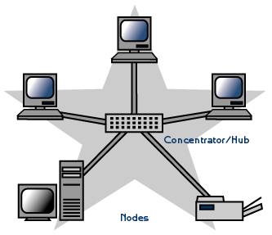
Star Topology
Advantages of a Star Topology
Easy to install and wire.
No disruptions to the network when connecting or removing devices.
Easy to detect faults and to remove parts.
less expensive than a mesh topology.
Disadvantages of a Star Topology
Requires more cable.
If the hub or switch fails, nodes attached are disabled.
More expensive than linear bus topologies because of the cost of the hubs.

Slide 30

Ring Topology
In a ring topology, each device has a dedicated point-to-point connection with only the two devices on either side of it.
A signal is passed along the ring in one direction, from device to device, until it reaches its destination.
Each device in the ring incorporates a repeater.
Today, the need for higher-speed LANs has made this topology less popular.

Slide 31

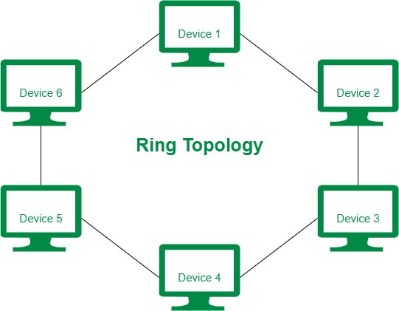
Advantages of a Ring Topology
A ring is relatively easy to install and reconfigure. Each device is linked to only its immediate neighbours.
To add or delete a device requires changing only two connections.
Generally, in a ring, a signal is circulating at all times. If one device does not receive a signal within a specified period, it can issue an alarm. The alarm alerts the network operator to the problem and its location.
Disadvantages of a Ring Topology
Unidirectional traffic

Slide 32
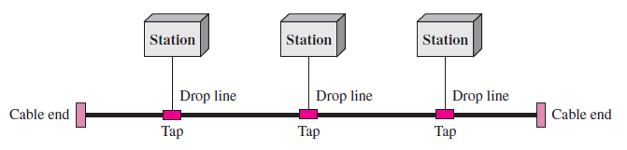
Bus Topology
Bus Topology: The preceding examples all describe point-to-point connections. A bus topology is multipoint topology. One long cable acts as a backbone to link all the devices in a network.

Slide 33
Bus Topology
Advantages:
Low-cost cable
Moderate data speeds: Coaxial or twisted pair cables are mainly used in bus-based networks that support upto 10 Mbps.
Limited failure: A failure in one node will not have any effect on other nodes.
Disadvantages:
A bus topology is quite simpler, but it requires a lot of cabling.
Difficult troubleshooting: It requires specialized test equipment to determine the cable faults. If any fault occurs in the cable, then it would disrupt the communication for all the nodes.
If two nodes send the messages simultaneously, then the signals of both the nodes collide with each other.
Adding new devices to the network would slow down the network.
Attenuation: Attenuation is a loss of signal leads to communication issues. Repeaters are used to regenerate the signal.

Slide 34
Cellular topology
The cellular topology is applicable only in case of wireless media that does not require cable connection.
In wireless media, each point transmits in a certain geographical area called a cell.
Each cell represents a portion of the total network area.
Devices that are in the cell communicate through a central hub. Hubs in different cells are interconnected. They route data across the network and provide a complete network infrastructure.

Slide 35
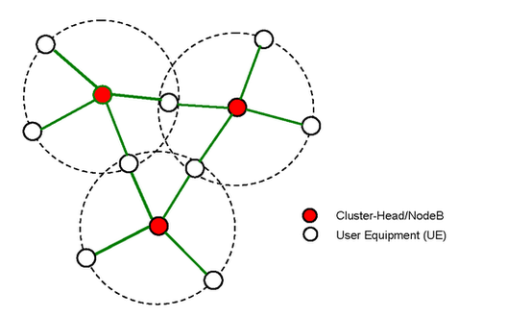
Cellular Topology

Slide 36
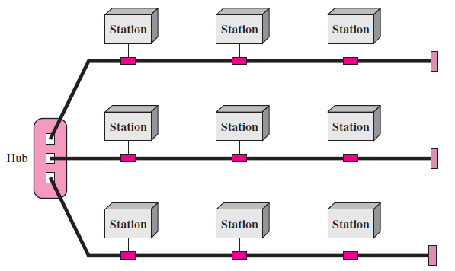
Hybrid Topology
A network can be hybrid. For example, we can have a main star topology with each branch connecting several stations in a bus topology.

Slide 37
ISO(International Standard Organization- OSI Reference Model (Open Systems Interconnection)
It was first introduced in the late 1970s. An open system is a set of protocols that allows any two different systems to communicate regardless of their underlying architecture.
The purpose of the OSI model is to show how to facilitate communication between different systems without requiring changes to the logic of the underlying hardware and software. The OSI model is not a protocol; it is a model for understanding and designing a network architecture that is flexible, robust, and interoperable.

Slide 38
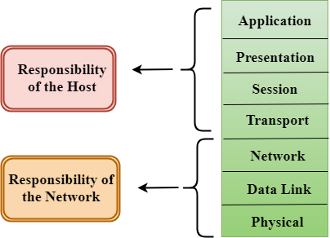
ISO- OSI Model Layers

Slide 39
OSI-Layered Architecture
The OSI model is composed of seven ordered layers.
Device A to device B. As the message travels from A to B, it may pass through many intermediate nodes. These intermediate nodes usually involve only the first three layers of the OSI model.
Each layer defines a family of functions distinct from those of the other layers.
By defining and localizing functionality in this fashion, the designers
created an architecture that is both comprehensive and flexible.
Most importantly, the OSI model allows complete interoperability between otherwise incompatible systems.

Slide 40




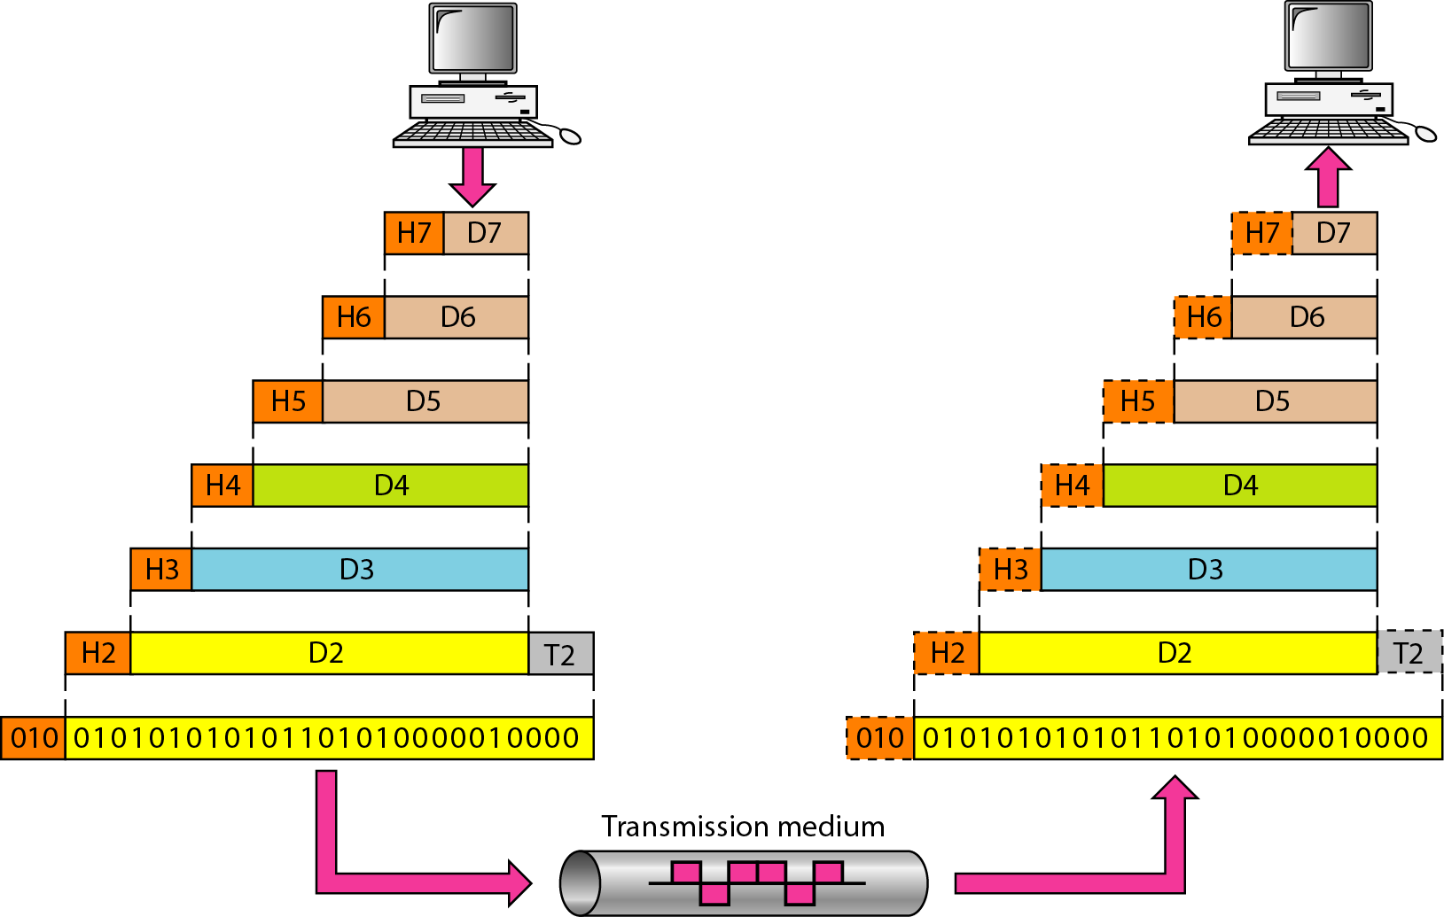
ISO- OSI Model Layers

Slide 41
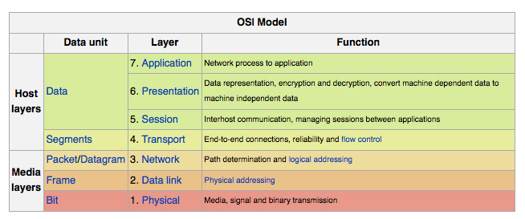

Slide 42
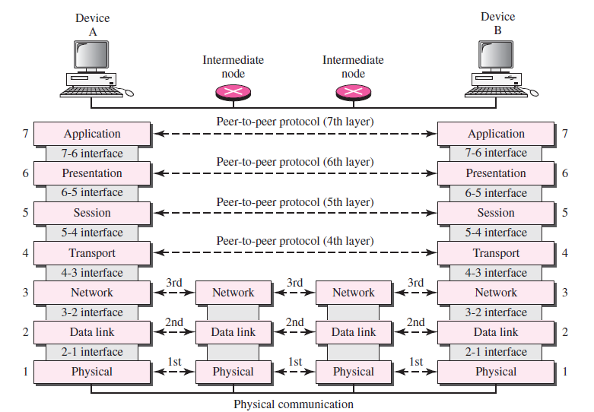

Slide 43
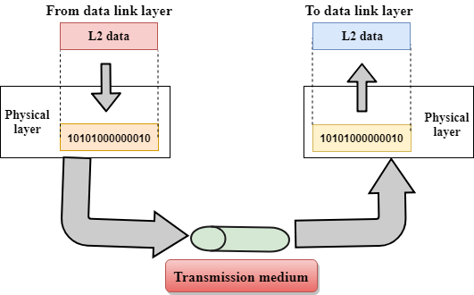
Physical Layer (Bit unit) Responsibilities
The lowest layer of the OSI reference model is the physical layer. It is responsible for the actual physical connection between the devices. The physical layer contains information in the form of bits. It is responsible for transmitting individual bits from one node to the next. When receiving data, this layer will get the signal received and convert it into 0s and 1s. It establishes, maintains and deactivates the physical connection.

Slide 44
Functions of Physical Layer
Bit synchronization: The physical layer provides the synchronization of the bits by providing a clock. This clock controls both sender and receiver thus providing synchronization at bit level.
Bit rate control: The Physical layer also defines the transmission rate i.e, the number of bits sent per second.
Physical topologies: Physical layer specifies the way in which the different devices/nodes are arranged in a network i.e., bus, star, or mesh topology.
Transmission mode: Physical layer also defines the way in which the data flows between the two connected devices. The various transmission modes possible are: Simplex, half-duplex and full duplex.
* Hub, Repeater, Modem, Cables are Physical Layer devices.

Slide 45
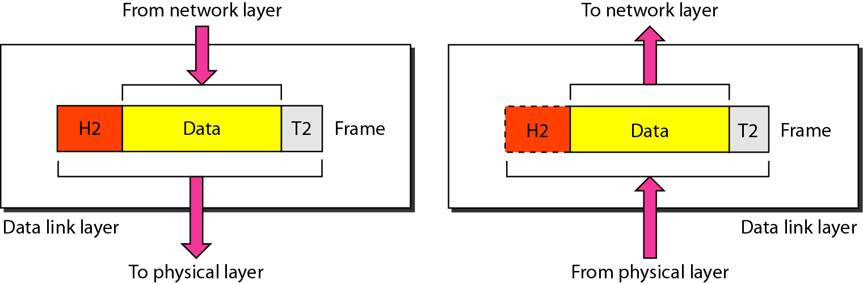
Data link Layer Responsibilities
Framing: It provides a way for a sender to transmit a set of bits that are meaningful to the receiver. This can be accomplished by attaching special bit patterns to the beginning and end of the frame.
Physical addressing: After creating frames, Data link layer adds physical addresses of sender and/or receiver in the header of each frame.
Error control: Data link layer provides the mechanism of error control in which it detects and retransmits damaged or lost frames.
Flow Control: The data rate must be constant on both sides else the data may get corrupted thus , flow control coordinates that amount of data that can be sent before receiving acknowledgement.
Access control: When a single communication channel is shared by multiple devices, it helps to determine which device has control over the channel at a given time.
* Packet in Data Link layer is referred as Frame.
** Switch & Bridge are Data Link Layer devices

Slide 46
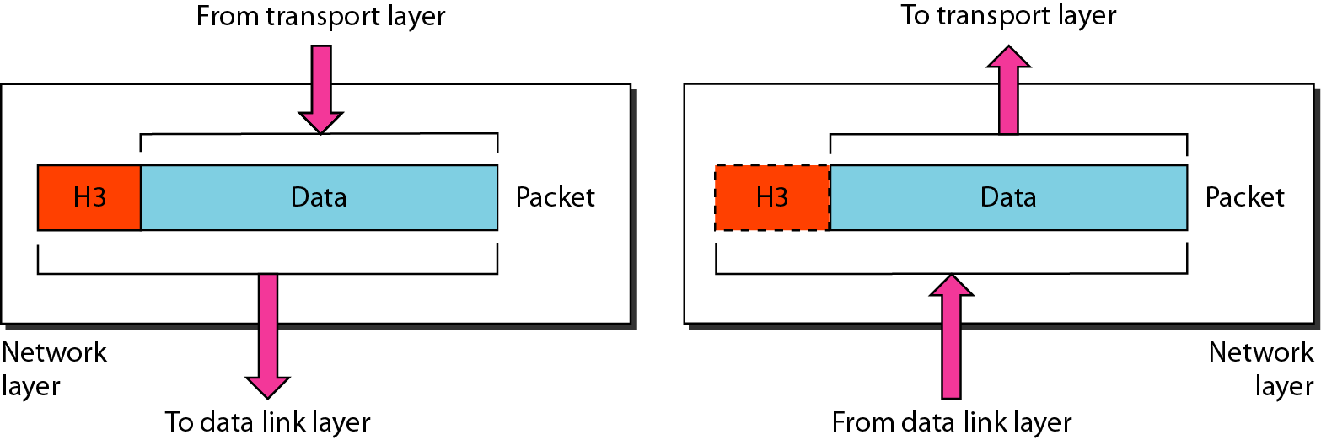
Functions of Network Layer Responsibilities
Internetworking: It provides a logical connection between different devices.
Addressing: A Network layer adds the source and destination address to the header of the frame. Addressing is used to identify the device on the internet.
Routing: It determines the best optimal path out of the multiple paths from source to the destination i.e. it takes care of packet routing i.e. selection of the shortest path to transmit the packet, from the number of routes available.
Packetizing: A Network Layer receives the data from the upper layer and converts them into packets. This process is known as Packetizing. It is achieved by internet protocol (IP).
* Segment in Network layer is referred as Packet.

Slide 47
Transport Layer/Segment unit Responsibilities
The data in the transport layer is referred to as Segments. It is responsible for the End to End( process to process) delivery of the complete message. The transport layer also provides the acknowledgement of the successful data transmission and re-transmits the data if an error is found.
At sender’s side
Transport layer receives the formatted data from the upper layers, performs Segmentation and also implements Flow & Error control to ensure proper data transmission. It also adds Source and Destination port number in its header and forwards the segmented data to the Network Layer.

Slide 48
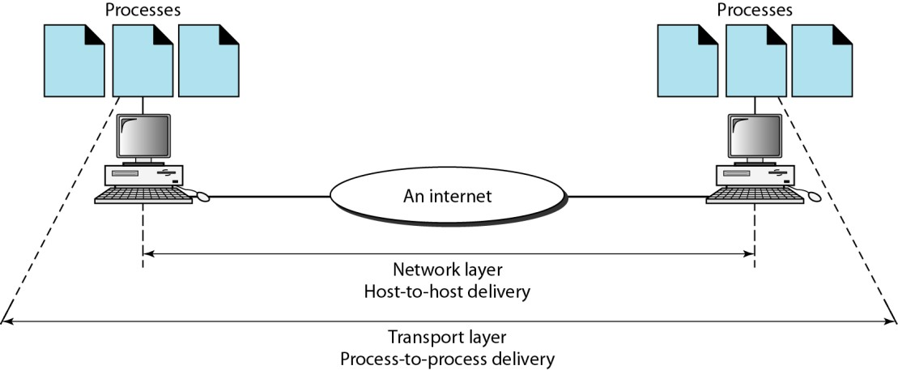
Transport Layer/Segment unit Responsibilities
At receiver’s side:
Transport Layer reads the port number from its header and forwards the Data which it has received to the respective application. It also performs sequencing and reassembling of the segmented data.

Slide 49
Transport Layer/Segment unit Responsibilities
Segmentation and Reassembly: This layer accepts the message from the (session) layer, breaks the message into smaller units. Each of the segment produced has a header associated with it. The transport layer at the destination station reassembles the message.
Service Point Addressing: To deliver the message to correct process, transport layer header includes a type of address called service point address or port address. Thus, by specifying this address, transport layer makes sure that the message is delivered to the correct process.
Error control and Flow control
The services provided by the transport layer:
Connection Oriented Service: It is a three-phase process which include
Connection Establishment -Data Transfer - Termination / disconnection
In this type of transmission, the receiving device sends an acknowledgement, back to the source after a packet or group of packet is received. This type of transmission is reliable and secure.

Slide 50
Transport Layer Responsibilities
2. Connection less service: It is a one-phase process and includes Data Transfer. In this type of transmission, the receiver does not acknowledge receipt of a packet. This approach allows for much faster communication between devices. Connection-oriented service is more reliable than connectionless Service.
* Data in the Transport Layer is called as Segments.
Transport Layer is called as Heart of OSI model.

Slide 51
Session Layer Responsibilities
The Session layer is used to establish, maintain and synchronizes the interaction between communicating devices.
Services
Dialog control: Session layer acts as a dialog controller that creates a dialog between two processes that allows the communication between two processes which can be either half-duplex or full-duplex.
Synchronization: Session layer adds some checkpoints when transmitting the data in a sequence. If some error occurs in the middle of the transmission of data, then the transmission will take place again from the checkpoint. This process is known as Synchronization and recovery.

Slide 52
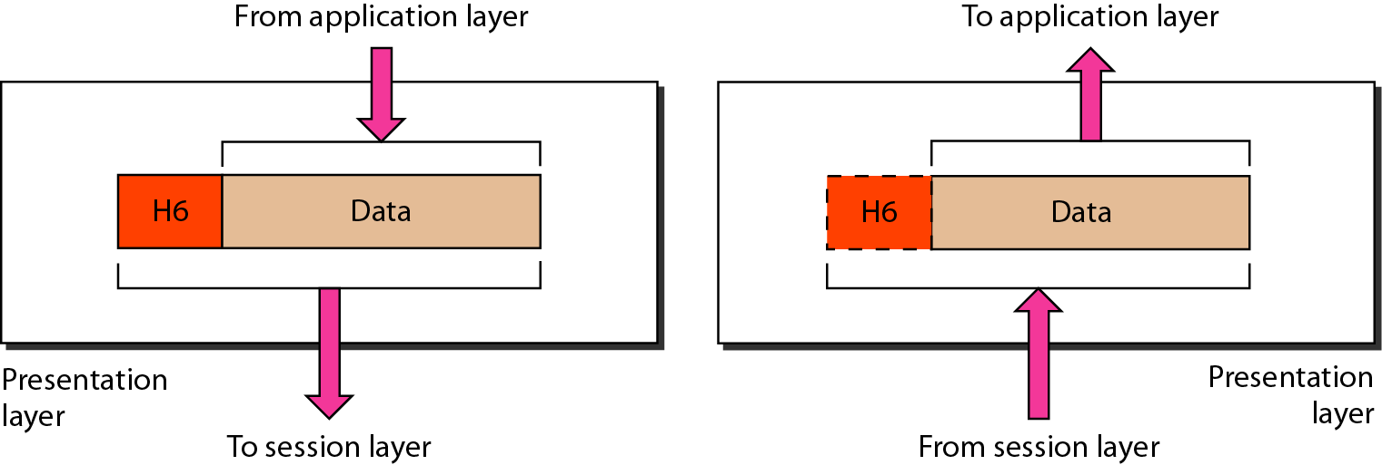
Presentation Layer Responsibilities
Presentation layer is also called the Translation layer. The data from the application layer is extracted here and manipulated as per the required format to transmit over the network. It is concerned with the syntax (format) and semantics (meaning) of the information exchanged between two systems.
Services provided by presentation layer
Translation: Converting the data into a common format so that both sender and receiver can accept it.
Encryption / Decryption: Data encryption translates the data into another form or code. The encrypted data is known as the cipher text and the decrypted data is known as plain text. A key value is used for encrypting as well as decrypting data.
Compression: Reduces the number of bits that need to be transmitted
on the network.

Slide 53
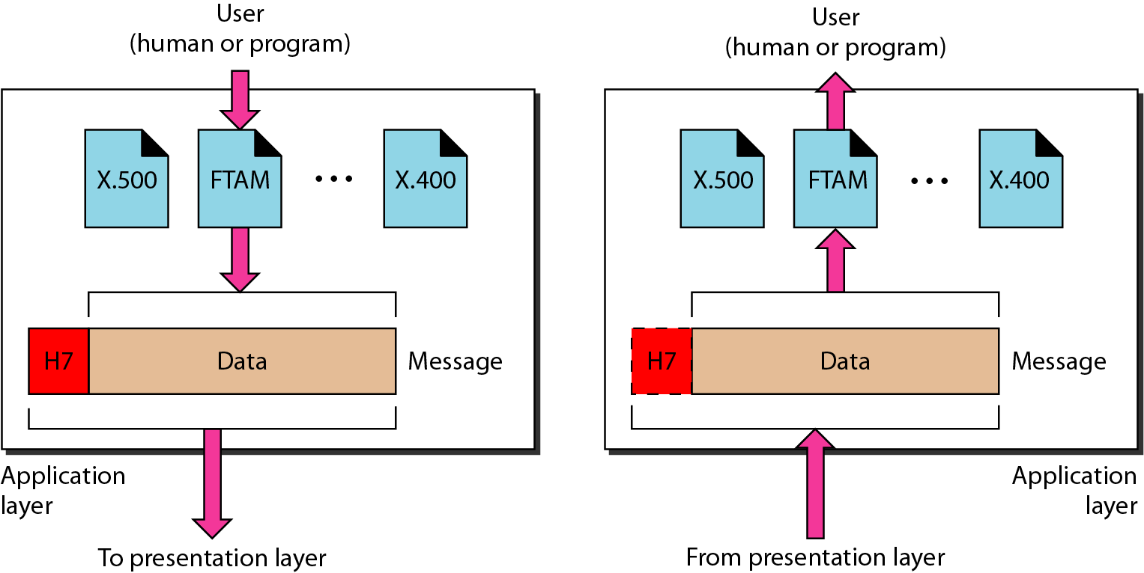
Application Layer Responsibilities
The application layer is the OSI layer that is closest to the user and it enables the user to access the network resources.
Services provided by Application layer
File Transfer and Access Management
Mail Services
Note: HTTP, FTP and SMTP protocols are used.

Slide 54
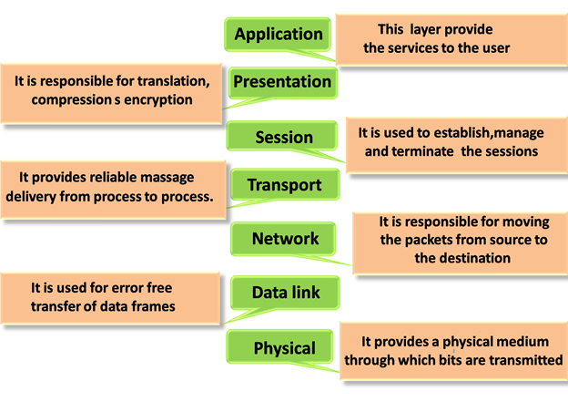
Functions of OSI Layers

Slide 55
TCP/IP Model
TCP/IP Model was designed and developed by Department of Defense (DoD) in 1960s and is based on standard protocols. It stands for Transmission Control Protocol/Internet Protocol. The TCP/IP model is a concise version of the OSI model. It contains four layers, unlike seven layers in the OSI model.
The layers are:
Application Layer
Transport Layer
Internet Layer
Network Access/Link Layer

Slide 56
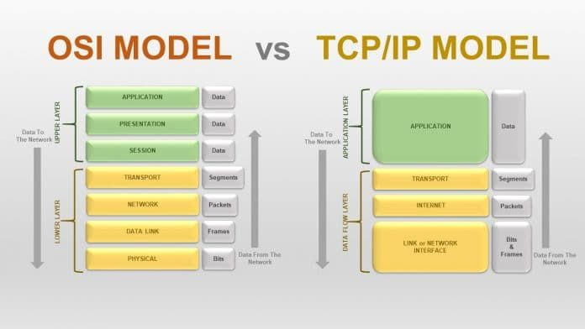

Slide 57
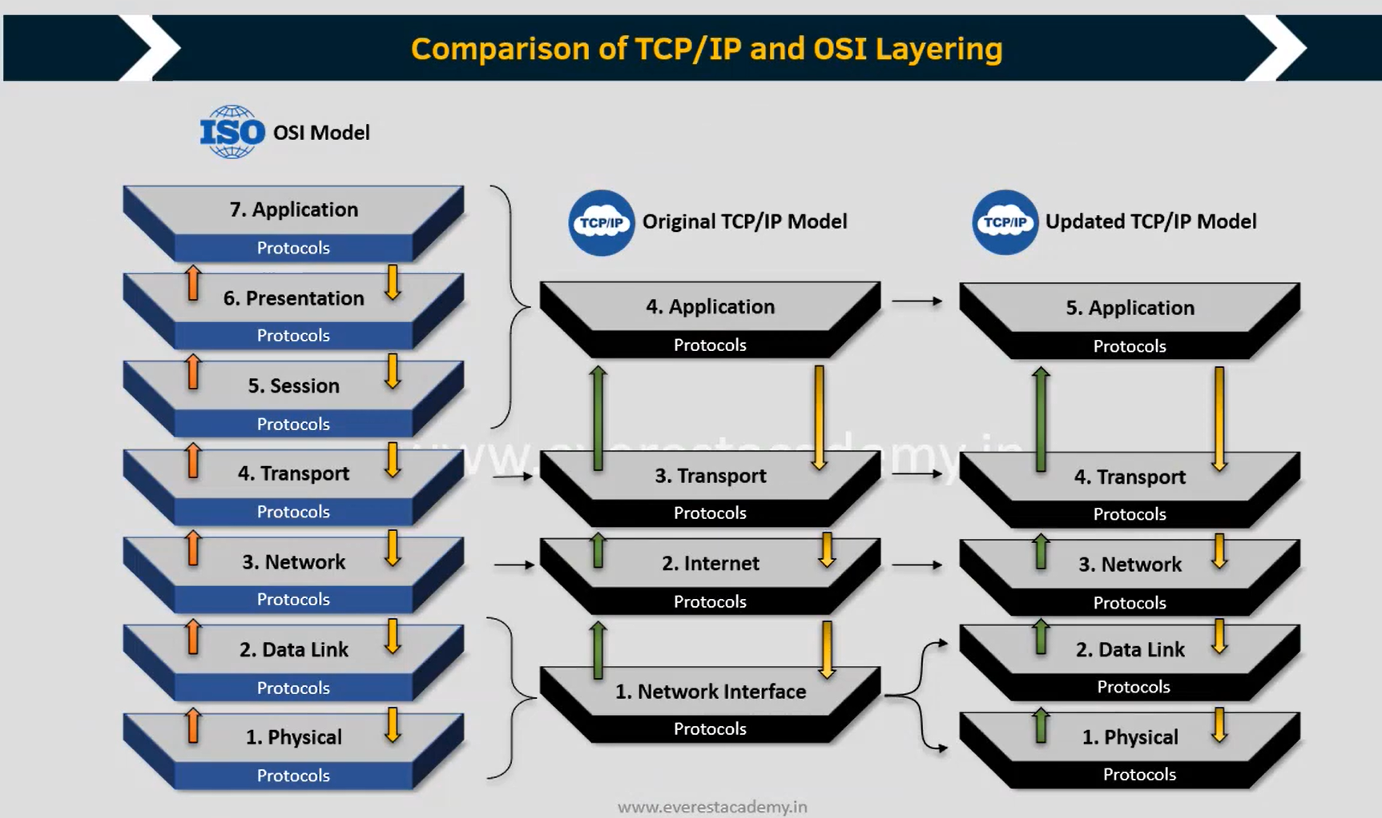
TCP/IP Model vs OSI Model

Slide 58
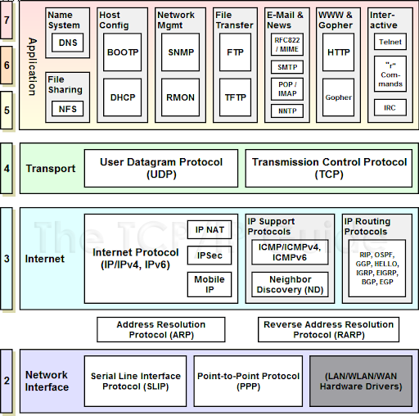
TCP/IP Model

Slide 59
Transmission Medium
Transmission medium can be broadly defined as anything that can carry information from a source to a destination.
The transmission medium is usually free space, metallic cable, or fiber-optic cable.
The information is usually a signal that is the result of a conversion of data from another form.

Slide 60
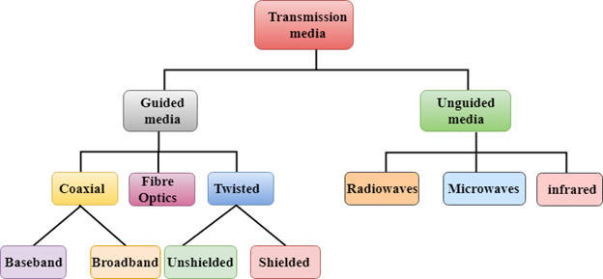
Transmission Medium Types
In telecommunications, transmission media can be divided into two broad categories: guided and unguided. Guided media include twisted-pair cable, coaxial cable, and fiber-optic cable. Unguided medium is free space

Slide 61
Guided Transmission Media
Guided media, which are those that provide a conduit (pipeline) form one device to another, include twisted-pair cable, coaxial cable, and fiber-optic cable.
Twisted-pair and Coaxial cable use metallic conductors that accept and transport signals in the form of electric current.
Optical fiber is a glass or plastic cable that accepts and transports
signals in the form of light.

Slide 62
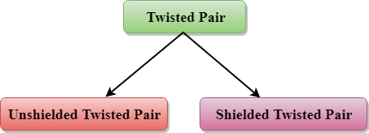
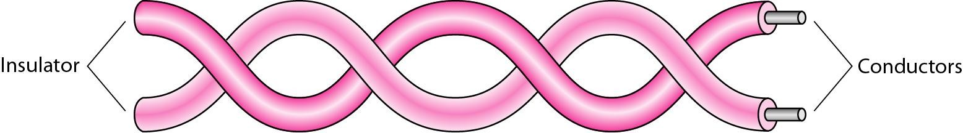
Twisted-Pair Cable
Twisted-pair cable is a type of cabling that is used for telephone communications and most modern Ethernet networks.
A pair of wires forms a circuit that can transmit data.
The pairs are twisted to provide protection against crosstalk, the
noise generated by adjacent pairs. (Star topology)
10 to 100 Mbps

Slide 63
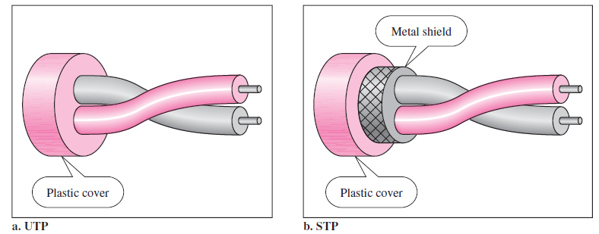

Slide 64
Un-Shielded Twisted-Pair Cable
Category 1: Category 1 is used for telephone lines that have low-speed data.
Category 2: It can support upto 4Mbps.
Category 3: It can support upto 16Mbps.
Category 4: It can support upto 20Mbps. Therefore, it can be used for long-distance communication.
Category 5: It can support upto 200Mbps.
Advantages Of Unshielded Twisted Pair:
It is cheap.
Installation of the unshielded twisted pair is easy.
It can be used for high-speed LAN.
Disadvantage:
This cable can only be used for shorter distances because of attenuation.

Slide 65
Shielded Twisted-Pair Cable
A shielded twisted pair is a cable that contains the mesh surrounding the wire that allows the higher transmission rate.
Characteristics Of Shielded Twisted Pair:
The cost of the shielded twisted pair cable is not very high and not very low.
An installation of STP is easy.
It has higher capacity as compared to unshielded twisted pair cable.
It has a higher attenuation.
It is shielded that provides the higher data transmission rate.
Disadvantages
It is more expensive as compared to UTP and coaxial cable.
It has a higher attenuation rate.

Slide 66
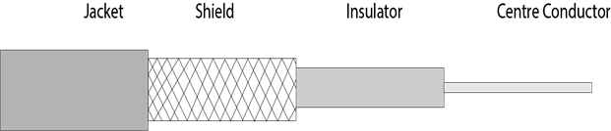
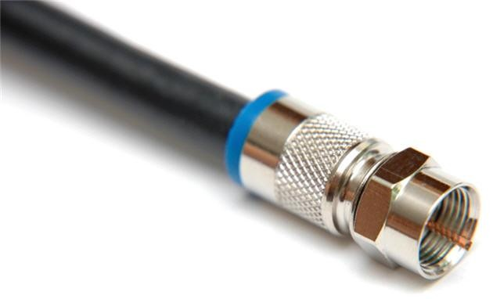
Co-axial Cable
Coaxial cable is very commonly used transmission media, for example, TV wire is usually a coaxial cable.
The name of the cable is coaxial as it contains two conductors parallel to each other.
It has a higher frequency as compared to Twisted pair cable.
The inner conductor of the coaxial cable is made up of copper, and the outer conductor is made up of copper mesh. The middle core is made up of non-conductive cover that separates the inner conductor from the outer conductor.
The middle core is responsible for the data transferring whereas the copper mesh prevents from the EMI(Electromagnetic interference).

Slide 67
Co-axial Cable
Coaxial cable is of two types:
Baseband transmission: It is defined as the process of transmitting a single signal at high speed.
Broadband transmission: It is defined as the process of transmitting multiple signals simultaneously.
Advantages Of Coaxial cable:
The data can be transmitted at high speed.
It has better shielding as compared to twisted pair cable.
It provides higher bandwidth.
Disadvantages Of Coaxial cable:
It is more expensive as compared to twisted pair cable.
If any fault occurs in the cable causes the failure in the entire network.

Slide 68
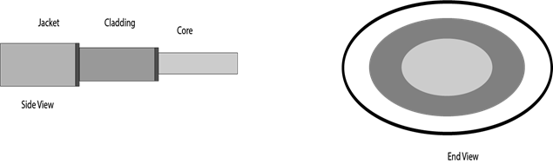
Optical Fiber Cable
Fiber optic cable is a cable that uses electrical signals for communication.
Fiber optic is a cable that holds the optical fibres coated in plastic that are used to send the data by pulses of light.
The plastic coating protects the optical fibres from heat, cold, electromagnetic interference from other types of wiring.
Fiber optics provide faster data transmission than copper wires.
Diagrammatic representation of fiber optic cable:

Slide 69
Fiber Optical Cable Advantages
Following are the advantages of fiber optic cable over copper:
Greater Bandwidth: The fiber optic cable provides more bandwidth as compared copper. Therefore, the fiber optic carries more data as compared to copper cable.
Faster speed: Fiber optic cable carries the data in the form of light. This allows the fiber optic cable to carry the signals at a higher speed.
Longer distances: The fiber optic cable carries the data at a longer distance as compared to copper cable.
Better reliability: The fiber optic cable is more reliable than the copper cable as it is immune to any temperature changes while it can cause obstruct in the connectivity of copper cable.
Thinner and Sturdier: Fiber optic cable is thinner and lighter in weight so it can withstand more pull pressure than copper cable.

Slide 70
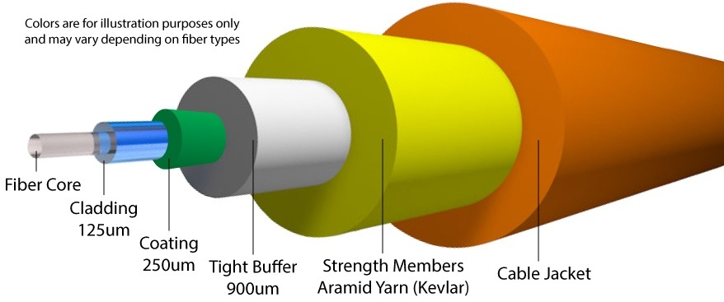

Slide 71
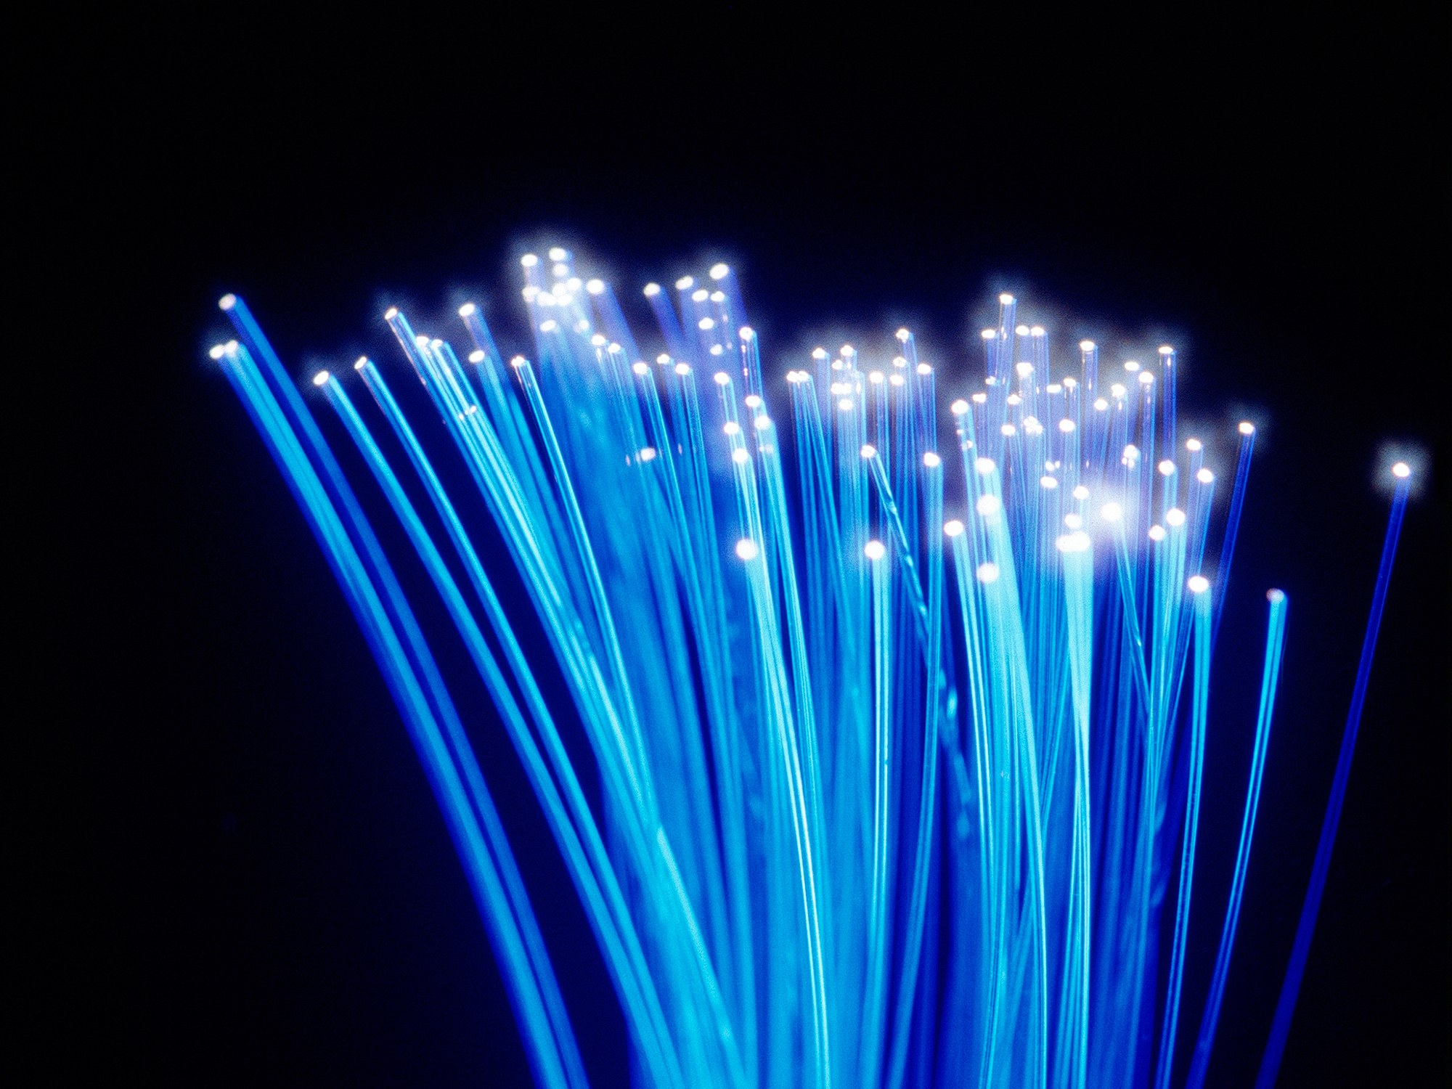

Slide 72
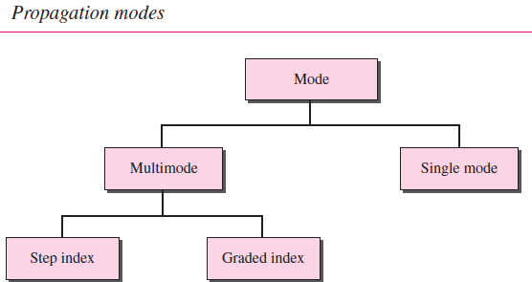
Propagation Modes

Slide 73
Multimode Multimode is so named because multiple beams from a light source move through the core in different paths.
In multimode step-index fiber, the density of the core remains constant from the center to the edges. A beam of light moves through this constant density in a straight line until it reaches the interface of the core and the cladding. At the interface, there is an abrupt change due to a lower density; this alters the angle of the beam’s motion. The term step index refers to the suddenness of this change, which contributes to the distortion of the signal as it passes through the fiber.
A second type of fiber, called multimode graded-index fiber, decreases this distortion of the signal through the cable. The word index here refers to the index of refraction. As we saw above, the index of refraction is related to density. A graded-index fiber, therefore, is one with varying densities. Density is highest at the center of the core and decreases gradually to its lowest at the edge

Slide 74
Single-Mode Single-mode uses step-index fiber and a highly focused source of light that limits beams to a small range of angles, all close to the horizontal. The singlemode fiber itself is manufactured with a much smaller diameter than that of multimode fiber, and with substantially lower density (index of refraction). The decrease in density results in a critical angle that is close enough to 90° to make the propagation of beams almost horizontal. In this case, propagation of different beams is almost identical, and delays are negligible. All the beams arrive at the destination “together” and can be recombined with little distortion to the signal.

Slide 75
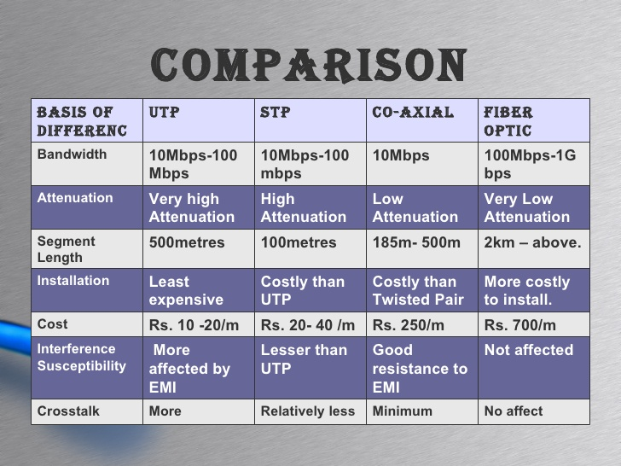

Slide 76
Unguided Media
Unguided media transport electromagnetic waves without using a physical conductor.
This type of communication is often referred to as wireless
communication.
Signals are normally broadcast through free space and thus are available to anyone who has a device capable of receiving them

Slide 77

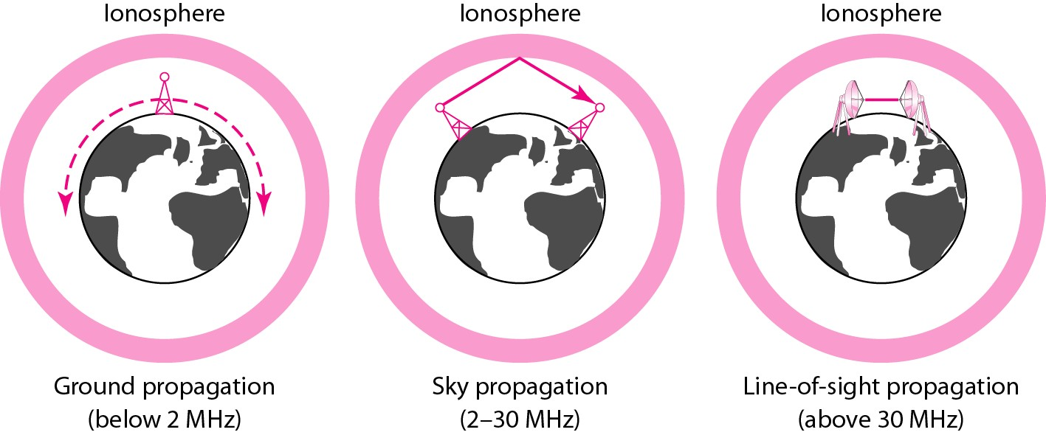
Propagation Methods used in unguided media

Slide 78
Propagation Methods
In ground propagation, radio waves travel through the lowest portion of the atmosphere, hugging the earth. These low-frequency signals emanate in all directions from the transmitting antenna and follow the curvature of the planet. Distance depends on the amount of power in the signal: The greater the power, the greater the distance.
In sky propagation, higher-frequency radio waves radiate upward into the ionosphere (the layer of atmosphere where particles exist as ions) where they are reflected back to earth. This type of transmission allows for greater distances with lower output power.

Slide 79
Propagation Methods
In line-or-sight propagation, very high-frequency signals are transmitted in straight lines directly from antenna to antenna. Antennas must be directional, facing each other, and either tall enough or close enough together not to be affected by the curvature of the earth. Line-of-sight propagation is tricky because radio transmissions cannot be completely focused.

Slide 80
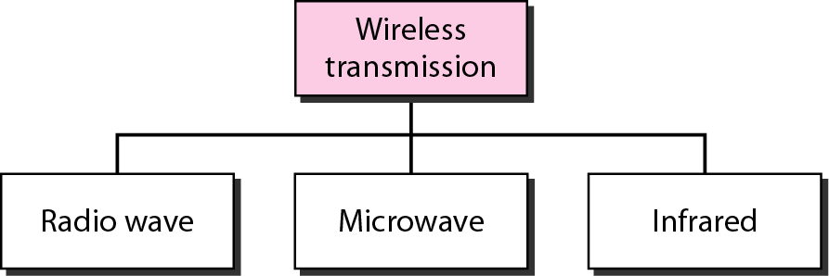
Wireless Transmission Waves

Slide 81

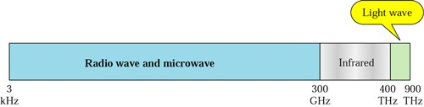
Frequency Spectrum of unguided Media

Slide 82
Radio Waves
Electromagnetic waves ranging in frequencies between 3 kHz and 1 GHz are normally called radio waves.
Radio waves, for the most part, are omnidirectional.
When an antenna transmits radio waves, they are propagated in all directions. This means that the sending and receiving antennas do not have to be aligned.
A sending antenna sends waves that can be received by any receiving antenna.
Used in Radio and Television

Slide 83
Radio Waves
The omnidirectional property has a disadvantage, too. The radio waves transmitted by one antenna are susceptible to interference by another antenna that may send signals using the same frequency or band. Radio waves, particularly those waves that propagate in the sky mode, can travel long distances. This makes radio waves a good candidate for long-distance broadcasting such as AM radio.
Radio waves, particularly those of low and medium frequencies, can penetrate walls.
It is an advantage because, for example, an AM radio can receive signals inside a building.
It is a disadvantage because we cannot isolate a communication to just inside or outside a building. The radio wave band is relatively narrow, just under 1 GHz, compared to the microwave band. When this band is divided into sub-bands, the sub-bands are also narrow, leading to a low data rate for digital communications.

Slide 84
MICROWAVES
Electromagnetic waves having frequencies between 1 and 300 GHz are called microwaves.
Microwaves are unidirectional.
When an antenna transmits microwave waves, they can be narrowly focused. This means that the sending and receiving antennas need to be aligned.
The unidirectional property has an obvious advantage. A pair of antennas can be aligned without interfering with another pair of aligned antennas.
Used in Telephone, Satellites and Wireless LAN

Slide 85
Characteristics of microwave propagation
Microwave propagation is line-of-sight. Since the towers with the mounted antennas need to be in direct sight of each other, towers that are far apart need to be very tall. The curvature of the earth as well as other blocking obstacles do not allow two short towers to communicate by using microwaves. Repeaters are often needed for long distance communication.
Very high-frequency microwaves cannot penetrate walls. This characteristic can be a disadvantage if receivers are inside buildings.
The microwave band is relatively wide, almost 299 GHz. Therefore, wider sub bands can be assigned, and a high data rate is possible
Use of certain portions of the band requires permission from authorities.

Slide 86
Infrared Waves
Infrared waves, with frequencies from 300 GHz to 400 THz (wavelengths from 1 mm to 770 nm), can be used for short-range communication. Infrared waves, having high frequencies, cannot penetrate walls. This advantageous characteristic prevents interference between one system and another; a short-range communication system in one room cannot be affected by another system in the next room. Infrared remote control does not interfere with the use of the remote by our neighbours. However, this same characteristic makes infrared signals useless for long-range communication. In addition, Infrared waves cannot be used outside a building because the sun’s rays contain infrared waves that can interfere with the communication.

Slide 87
Computer Network Types
LAN(Local Area Network)
PAN(Personal Area Network)
MAN(Metropolitan Area Network)
WAN(Wide Area Network)
CAN (Campus Area Network)

Slide 88
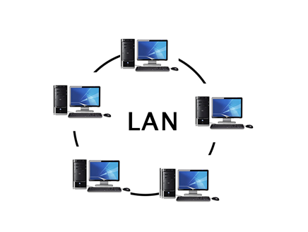
Local Area Network (LAN)
LAN is usually privately owned and links the devices in a single office, building or campus of up to few kilometers in size.
LAN typically used transmission technology consisting of single cable to which all machines are connected.
LANs are restricted in size, which means that the worst-case transmission time is bounded and known in advance.
Traditional LANs run at speeds of 100Mbps to 1Gbps. (but now much higher speeds can be achieved).
The topology of many wired LANs is built from point-to-point links. IEEE 802.3, popularly called Ethernet.

Slide 89
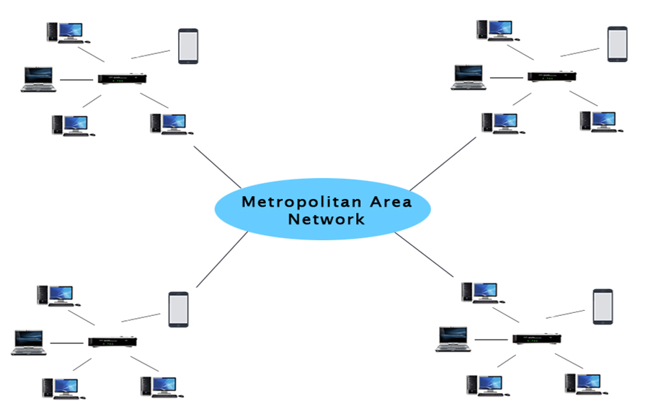
Metropolitan Area Network (MAN)
MAN is designed to extend over the entire city. It may be a single network as a cable TV
MAN is wholly owned and operated by a private company or may be a service provided by a public company.
The main reason for distinguishing MANs as a special category is that a standard has been adopted for them.
It is DQDB (Distributed Queue Dual Bus) or IEEE 802.6.

Slide 90
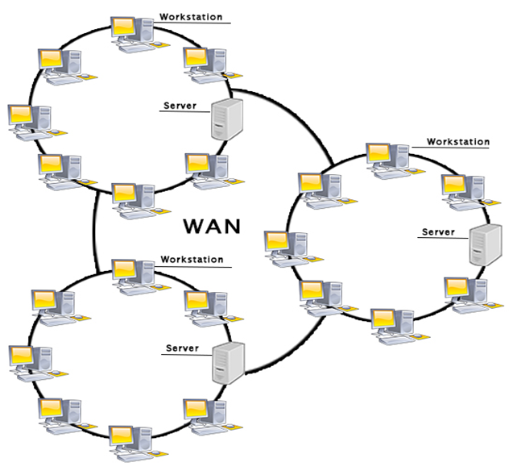
Wide Area Network (WAN)
A WAN is a network that extends over a large geographical area such as states or countries.
A WAN is quite bigger network than the LAN.
A WAN is not limited to a single location, but it spans over a large geographical area through a telephone line, fiber optic cable or satellite links.
The internet is one of the biggest WAN in the world.
A WAN is widely used in the field of Business, government, and education.

Slide 91

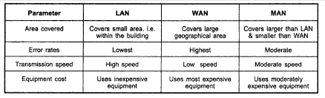
Comparison among LAN MAN WAN

Slide 92
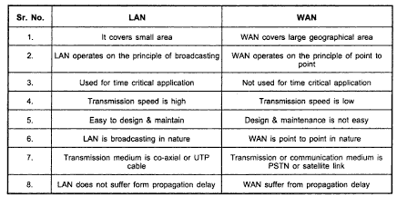
Comparison between LAN & WAN

Slide 93
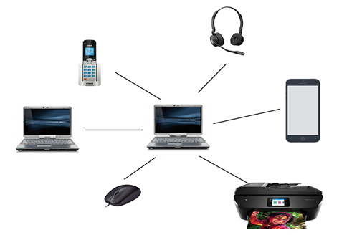
PAN(Personal Area Network)
Personal Area Network is a network arranged within an individual person, typically within a range of 10 meters.
Personal Area Network is used for connecting the computer devices of personal use is known as Personal Area Network.
Thomas Zimmerman was the first research scientist to bring the idea of the Personal Area Network.
Personal Area Network covers an area of 30 feet.
Personal computer devices that are used to develop the personal area network are the laptop, mobile phones, media player and play stations.

Slide 94
Wireless Local Area Network (WLAN)
A wireless local area network (WLAN) provides wireless network communication over short distances using radio or infrared signals instead of traditional network cabling. A WLAN is a type of local area network (LAN).
A WLAN can be built using any of several different wireless network protocols, most commonly either Wi-Fi or Bluetooth.
Network security remains an important issue for WLANs. Wireless clients usually must have their identity verified (a process called authentication) when joining a wireless LAN.
Technologies like WPA raise the level of security on wireless networks to rival that of traditional wired networks. Standards for WLAN are 802.11a, 802.11b, 802.11n, 802.11g

Slide 95
WLAN
Pros:
A large number of devices are supported
It's easy to set up a WLAN, especially when compared to laying cables for wired networks
Accessing a WLAN is easier than a wired LAN since cable length isn't a factor.
WLANs are common even when away from a business or home, like in public areas
Cons:
It's easier to hack a WLAN, which is why encryption is necessary
Wireless interference can hijack the speed and stability of a wireless network
More wireless devices, like repeaters, are needed to expand a wireless network

Slide 96
BLUETOOTH
Bluetooth is a wireless LAN technology designed to connect devices of different functions such as telephones, notebooks, computers (desktop and laptop) and so on.
A Bluetooth LAN is an ad hoc network, which means that the network is formed spontaneously; the devices, sometimes called gadgets, find each other and make a network called a piconet.
A Bluetooth LAN can even be connected to the Internet if one of the gadgets has this capability.
A Bluetooth LAN, by nature, cannot be large. If there are many gadgets that try to connect, there is chaos.
Today, Bluetooth technology is the implementation of a protocol defined by the IEEE 802.15 standard. The standard defines a wireless personal-area network (PAN) operable in an area the size of a room or a hall.

Slide 97
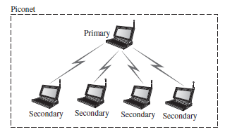
Architecture of Bluetooth
A Bluetooth network is called a piconet, or a small net. A piconet can have up to eight stations, one of which is called the primary; the rest are called secondaries. All the secondary stations synchronize their clocks and hopping sequence with the primary. The communication between the primary and the secondary can be one-to-one or one-to-many.

Slide 98
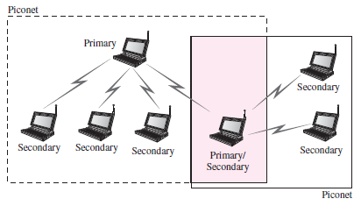
Scatternet
Piconets can be combined to form what is called a scatternet. A secondary station in one piconet can be the primary in another piconet. This station can receive messages from the primary in the first piconet (as a secondary) and, acting as a primary, deliver them to secondaries in the second piconet. A station can be a member of two piconets.

Slide 99
CONNECTING LAN
CONNECTING DEVICES
The five categories contain devices which can be defined as
1. Those which operate below the physical layer such as a passive hub.
2. Those which operate at the physical layer (a repeater or an active hub).
3. Those which operate at the physical and data link layers (a bridge or a two-layerswitch).
4. Those which operate at the physical, data link, and network layers (a router or a three-layer switch).
5. Those which can operate at all five layers (a gateway).

Slide 100
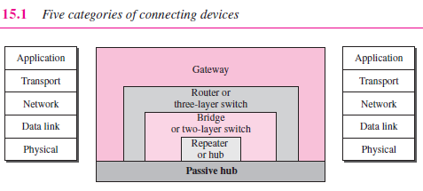

Slide 101
Passive Hubs
A passive hub is just a connector. It connects the wires coming from different branches. In a star-topology Ethernet LAN, a passive hub is just a point where the signals coming from different stations collide; the hub is the collision point.
Repeaters
A repeater is a device that operates only in the physical layer. Signals that carry information within a network can travel a fixed distance before attenuation endangers the integrity of the data. A repeater receives a signal and, before it becomes too weak or corrupted, regenerates the original bit pattern. The repeater then sends the refreshed signal.
Active Hubs
An active hub is actually a multiport repeater. It is normally used to create connections between stations in a physical star topology.
Hubs

Slide 102
Bridges
A bridge operates in both the physical and the data link layer. As a physical layer device, it regenerates the signal it receives. As a data link layer device, the bridge can check the physical (MAC) addresses (source and destination) contained in the frame.
Two-Layer Switches
The two-layer switch performs at the physical and data link layers.A two-layer switch is a bridge, a bridge with many ports and a design that allows better (faster) performance. A bridge with a few ports can connect a few LANs together. A bridge with many ports may be able to allocate a unique port to each station, with each station on its own independent entity. This means no competing traffic.

Slide 103
Routers
A router is a three-layer device that routes packets based on their logical addresses (host-to-host addressing). A router normally connects LANs and WANs in the Internet and has a routing table that is used for making decisions about the route. The routing tables are normally dynamic and are updated using routing protocols.
Three-Layer Switches
A three-layer switch is a router, but a faster and more sophisticated. The switching fabric in a three-layer switch allows faster table lookup and forwarding.

Slide 104
Gateway
A gateway is normally a computer that operates in all five layers of the Internet or seven layers of OSI model. A gateway takes an application message, reads it, and interprets it. This means that it can be used as a connecting device between two internetworks that use different models. For example, a network designed to use the OSI model can be connected to another network using the Internet model. The gateway connecting the two systems can take a frame as it arrives from the first system, move it up to the OSI application layer, and remove the message.

